Slide 1
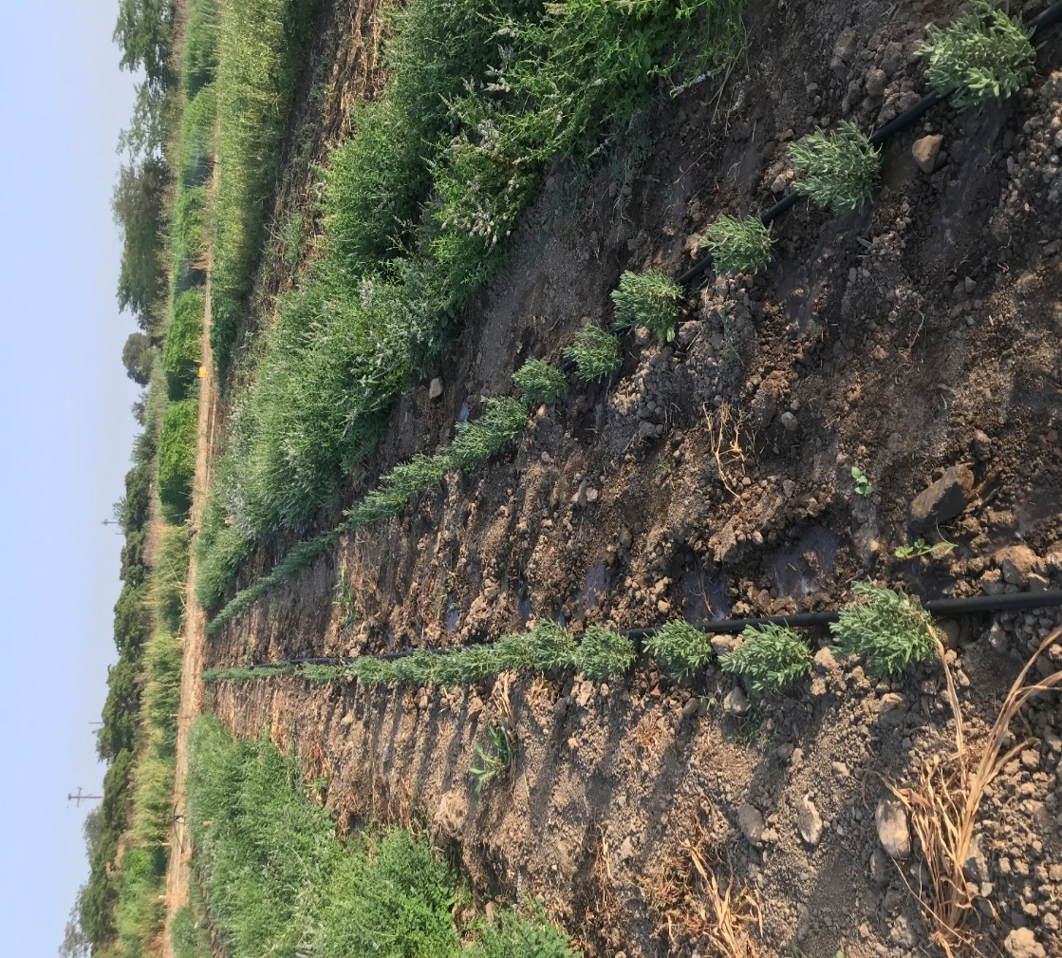
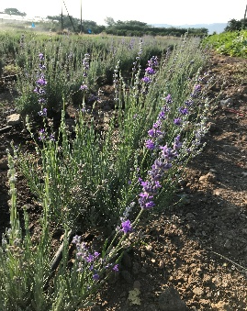
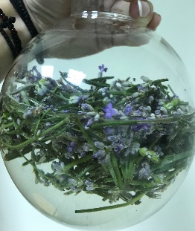
THE EFFECTS OF BIOSTIMULANTS ON Lavandula angustifolia CULTIVATION UNDER DEFICIT IRRIGATION
Christina CHASKI, Eleftheria BATZIOU, Kyriakos D. GIANNOULIS, Spyridon A. PETROPOULOS*
University of Thessaly, Department of Agriculture, Crop Production and Rural Environment, Fytokou Street, 38446, Volos, Greece
*Corresponding author: spetropoulos@uth.gr
INTRODUCTION
RESULTS AND DISCUSSION
CONCLUSIONS
Biostimulants are naturally derived substances that enhance plant growth and yield by stimulating physiological and metabolic processes, facilitating improved nutrient uptake, and alleviating the impacts of abiotic stresses on plants (Bulgari et al.,2015).
The purpose of this study is to evaluate the effect of the application of four different biostimulants and deficit irrigation on biomass yield and essential oil production of lavender plants.
Table 1. Essential oil concentration (%) on different irrigation levels and on different biostimulant treatments.
Deficit irrigation increased essential oil production by 40% and 88% in I1 and I2 treatments, respectively (Table 1).
Treatment Tr4 resulted in the highest essential oil yield (1.67%), whereas Tr1 showed the lowest content (0.98%) being significantly different from the rest of the treatments. (Table 1).
Our results are in line with Baher et al. (2002) who reported that deficit irrigation increased the essential oil content in Satureja hortensis L., while a decrease in the overall essential oil yield was recorded.
The outcomes of our study revealed that a reduction in water supply (including irrigation water and precipitation) by 16% and 31% resulted in decline in fresh weight by up to 32% and 72%, respectively (Tables 2 and 3). In particular, fresh weight was reduced from 1220 to 832 kg/ha when plants received irrigation that accounted for 80% of field capacity, while a further decrease to 338 kg/ha was recorded for I1 treatment (60% of field capacity) (Table 3). Daszkowska-Golec et al. (2018) indicated that water stress led to a decrease in photosynthetic activity which resulted in decreased biomass yield. Similarly, Amani Machiani et al. (2019) reported a reduction by 27% and 40% in the dry matter yield of thyme (Thymus vulgaris L.) plants subjected to moderate and severe drought stress, respectively.
According to our results the highest biomass yield was observed in treatment I3 compared to I2 and I1 (Table 4). In addition, a positive effect of the biostimulants on the lavender plants was observed as in treatment I3 the biostimulant Tr3 recorded 1501.8 kg/ha. Although in the I2 treatment no particular influence was observed from the biostimulants as the control yielded 1373.8 kg/ha, Tr2 showed the best results compared to the other biostimulants and the control treatment (Table 5).
In summary, the biostimulants showed a positive effect on lavender plants under deficit irrigation conditions. In particular, regarding fresh yield production, the biostimulant containing proteins, amino acids and algae (Tr2) showed the best response to stress conditions in relation to the rest of the biostimulants.
Moreover, the effect of biostimulants on the essential oil concentration (%) was evident, especially for biostimulant Tr4 which contained CaO and SiO2 + Calcium Mobilization and Translocation Agents + Micronutrients.
The application of biostimulants in the cultivation of aromatic and medicinal plants shows promising potential aiming to increase the essential oil content of plants, especially under deficit conditions. Nevertheless, additional research is needed to the actual mechanisms through which each biostimulant formulation may affect the essential oil content and composition under abiotic stress conditions.
ESSENTIAL OIL CONCENTRATION (%) | ESSENTIAL OIL CONCENTRATION (%)
IRRIGATION
I1 | 1.86
I2 | 1.38
I3 | 0.99
LSD | 0.279
BIOSTIMULANTS
Tr1 | 0.98
Tr2 | 1.53
Tr3 | 1.38
Tr4 | 1.67
Tr5 | 1.49
LSD | 0.240
METHODOLOGY
Lavender seedlings were transplanted in the field on April 2022, at the experimental farm of University of Thessaly, Velestino, Greece.
Treatments: Tr1: vegetable proteins + amino acids + 5% carboxylic acids; Tr2: vegetable proteins + amino acids + seaweed extracts; Tr3: 0.3% Stabilized Orthosilicic Acid; Tr4: 35% CaO and 35% SiO2 + Calcium Mobilization and Translocation Factor + 1% Mo, 15% Bo and 30% Zn; and the control treatment Tr5: no biostimulants added).
Irrigation levels: I1: 60% of field capacity; I2: 80% of field capacity and I3: 100% of filed capacity.
The harvest of antennas took place in September 2022.
Essential oil extraction was implemented with a Clevenger apparatus.
Table 2. Water supply.
 | Total (mm) | % mm | % reduction
I1 | 241 | 69 | 31
I2 | 296 | 84 | 16
I3 | 351 | 100
*Total (mm): Irrigation+precipitation
REFERENCES
Table 3. Fresh yield.
Amani Machiani, M., Javanmard, A., Morshedloo, M. R., Aghaee, A. & Maggi, F. Funneliformis mosseae inoculation under water defcit stress improves the yield and phytochemical characteristics of thyme in intercropping with soybean. Sci. Rep. 2021 11, 15279.
Baher, Z.F.; Mirza, M.; Ghorbanli, M.; Rezaii, M.B. The influence of water stress on plant height, herbal and essential oil yield and composition in Satureja hortensis L. Flavour. Fragr. J. 2002, 17, 275–277.
Bulgari, R.; Cocetta, G.; Trivellini, A.; Vernieri, P.; Ferrante, A. Biostimulants and crop responses: A review. Biol. Agric. Hortic. 2015, 31, 1–17.
Daszkowska-Golec, A., & Szarejko, I. Open or close the gate - stomata action under the control of phytohormones in drought stress conditions. Frontiers in plant science, 2013 4, 138.
 | FW | % FW | % reduction
I1 | 338 | 28 | 72
I2 | 832 | 68 | 32
I3 | 1220 | 100
Table 4. Total fresh yield (kg/ha) on different irrigation levels and on different biostimulant treatments.
Irrigation | Total fresh yield (kg/ha) | Biostimulants | Total fresh yield (kg/ha)
1 | 338 | 1 | 443
2 | 832 | 2 | 861
3 | 1220 | 3 | 877
 |  | 4 | 789
 |  | 5 | 1013
Table 5. Total fresh harvested yield (TFY; kg/ha) in relation to biostimulant application and deficit irrigation.
Irrigation | Biostimulants | T.F.Y. Kg/ha
1 | 1 | 174.3
 | 2 | 476.2
 | 3 | 410.5
 | 4 | 384.6
 | 5 | 390.3
2 | 1 | 251.9
 | 2 | 1020.4
 | 3 | 720.1
 | 4 | 795.2
 | 5 | 1373.8
3 | 1 | 1045.4
 | 2 | 1087.3
 | 3 | 1501.8
 | 4 | 1188.4
 | 5 | 1275.4
 | LSD | 150.7
ACKNOWLEDGMENTS
This research has been co‐financed by the European Regional Development Fund of the European Union and Greek national funds through the Operational Program Competitiveness, Entrepreneurship and Innovation, under the call RESEARCH – CREATE – INNOVATE (project code:T2EDK-05281).
Fig 1. Water use efficiency.
The graphical presentation of water use efficiency (WUE), depicts a linear biomass increase with increasing water supply (Fig. 1).

